Slide 1



Neural Learning to Rank
Bhaskar Mitra
Principal Researcher, Microsoft
@UnderdogGeek
bmitra@microsoft.com

Slide 2

Reading material
An Introduction to
Neural Information Retrieval
Foundations and Trends® in Information Retrieval
(December 2018)
Download PDF: http://bit.ly/fntir-neural
FREE COPIES

Slide 3
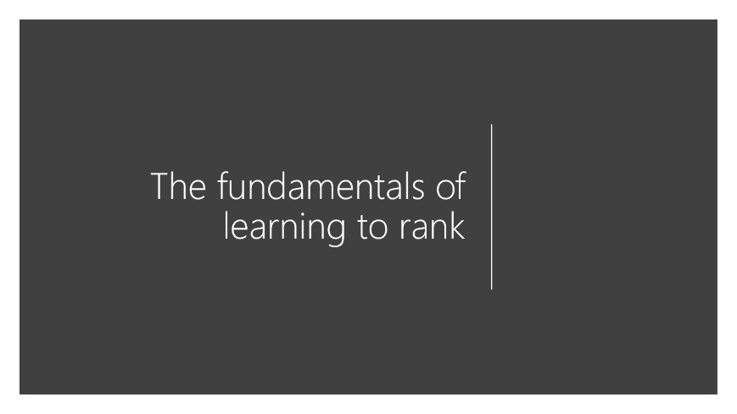

Agenda

Slide 4
A gentle introduction to neural networks

Slide 5
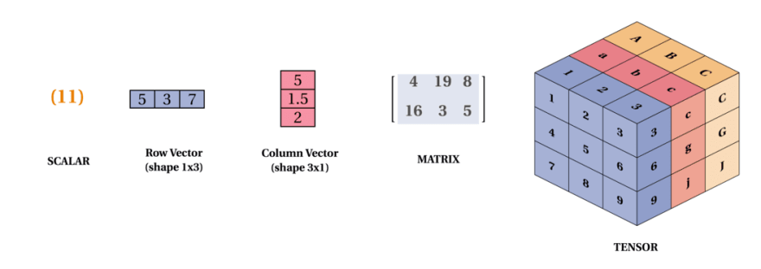
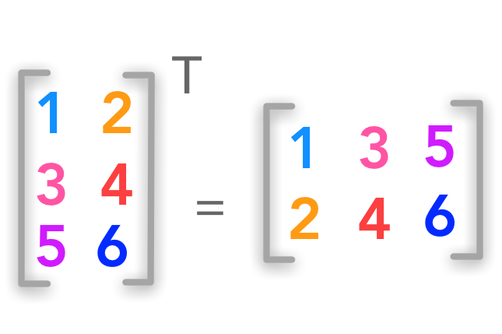
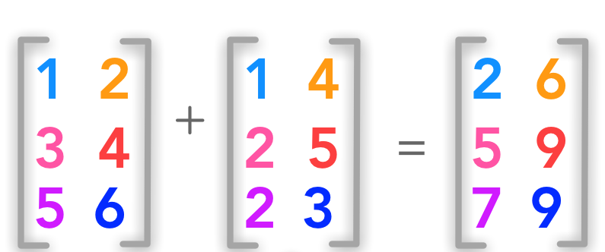
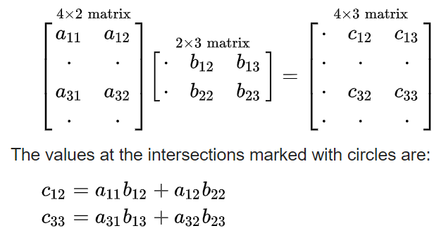
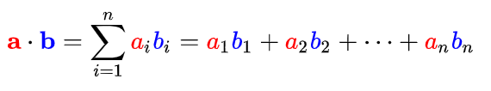
Vectors, matrices, and tensors
matrix transpose
matrix addition
dot product
matrix multiplication
Image source: https://dev.to/mmithrakumar/scalars-vectors-matrices-and-tensors-with-tensorflow-2-0-1f66
Image source: https://hadrienj.github.io/posts/Deep-Learning-Book-Series-2.1-Scalars-Vectors-Matrices-and-Tensors/

Slide 6
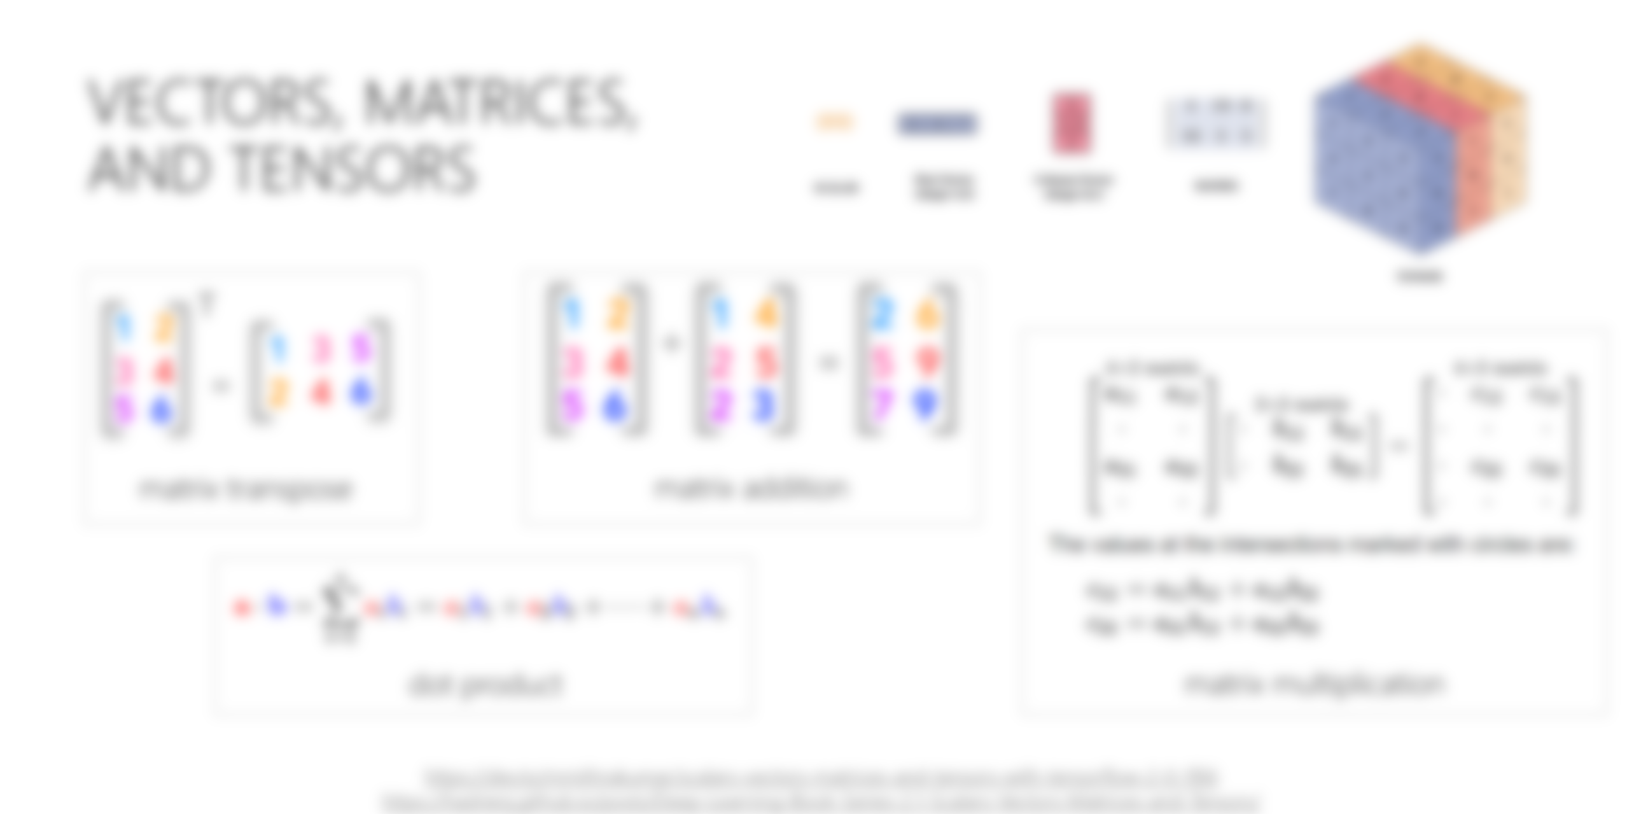
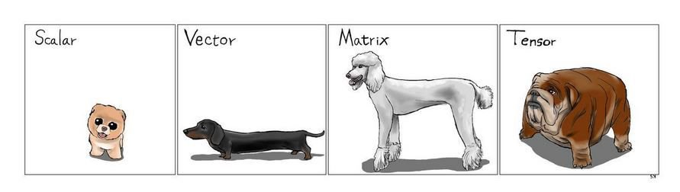

Slide 7
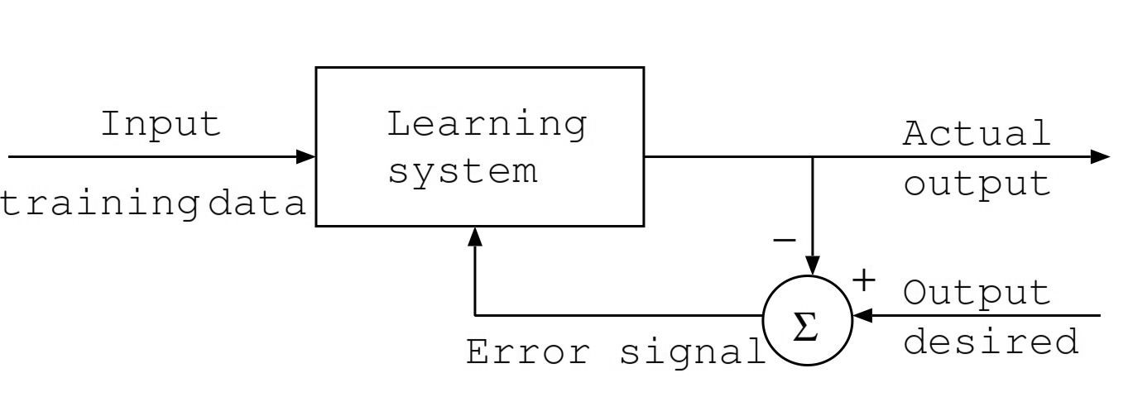
Supervised learning
Image source: https://www.intechopen.com/books/artificial-neural-networks-architectures-and-applications/applying-artificial-neural-network-hadron-hadron-collisions-at-lhc

Slide 8
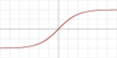

Neural networks
Expected output
loss
Predicted output
Non-linearity
Chains of parameterized linear transforms (e.g., multiply weight, add bias) followed by non-linear functions (σ)
Popular choices for σ:
Parameters trained using backpropagation
E2E training over millions of samples in batched mode
Many choices of architecture and hyper-parameters
Linear transform
forward pass
backward pass
Tanh
ReLU
Non-linearity
Linear transform
Input

Slide 9
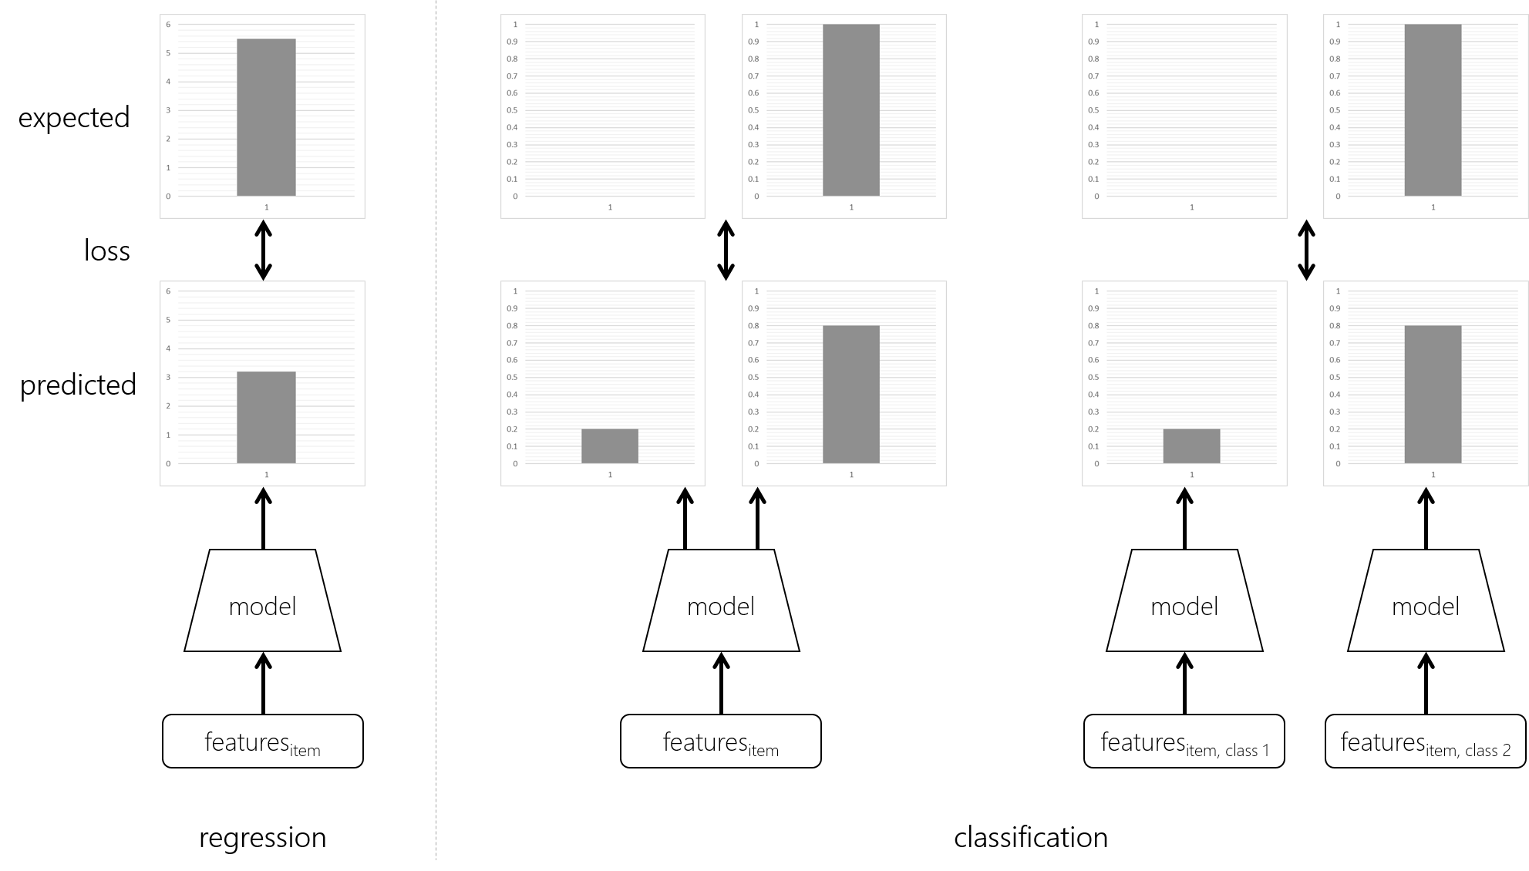
Basic machine learning tasks

Slide 10
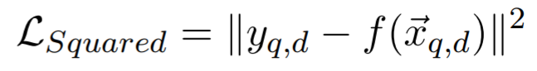
Squared loss
The squared loss is a popular loss function for regression tasks

Slide 11
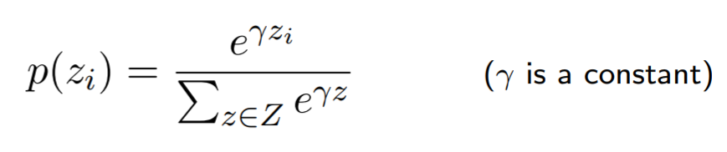
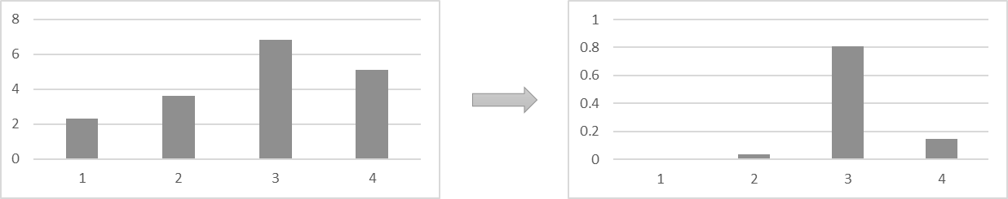
The softmax function
In neural classification models, the softmax function is popularly used to normalize the neural network output scores across all the classes

Slide 12
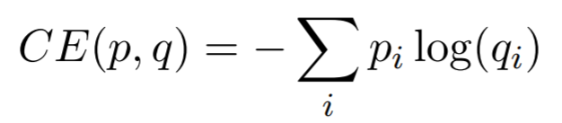
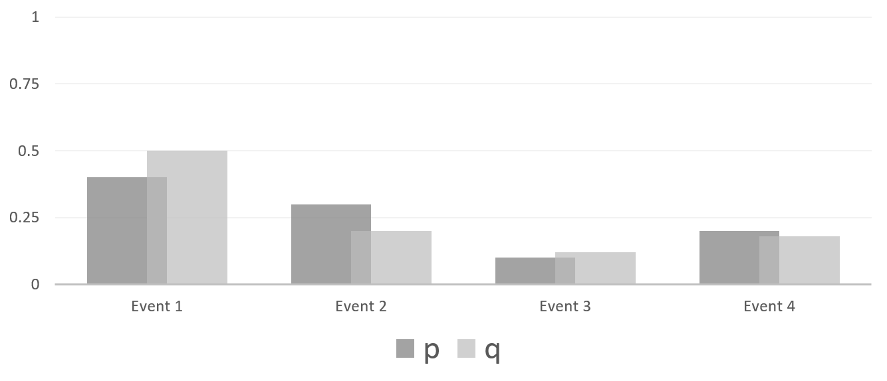
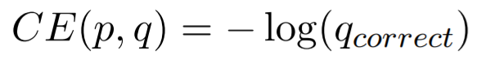
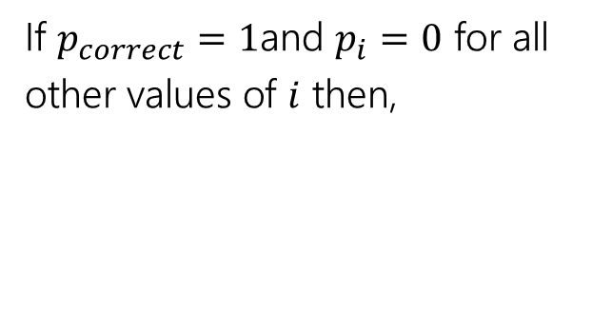
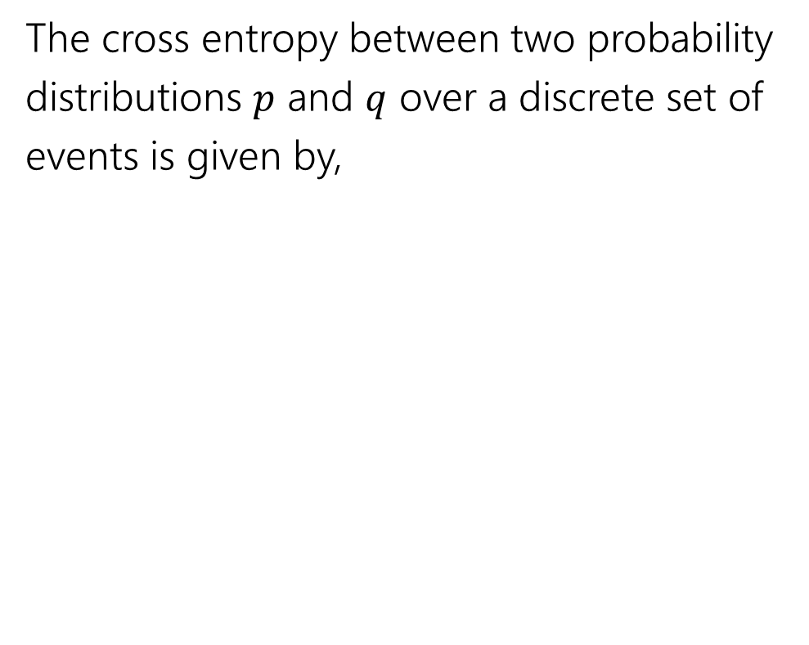
Cross entropy
The cross entropy between two probability distributions $p$ and $q$ over a discrete set of events is given by,
If $p_{correct}=1$and $p_{i}=0$ for all other values of $i$ then,

Slide 13
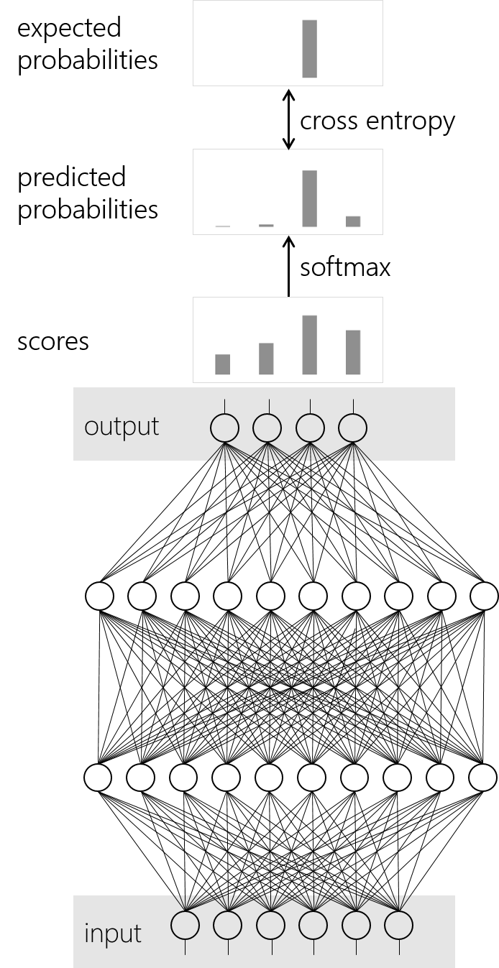
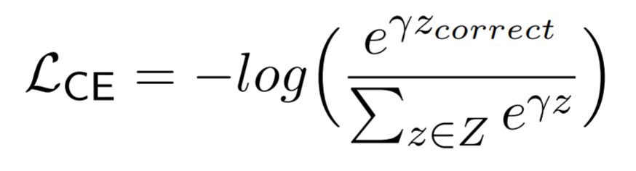
Cross entropy with softmax loss
Cross entropy with softmax is a popular loss function for classification

Slide 14
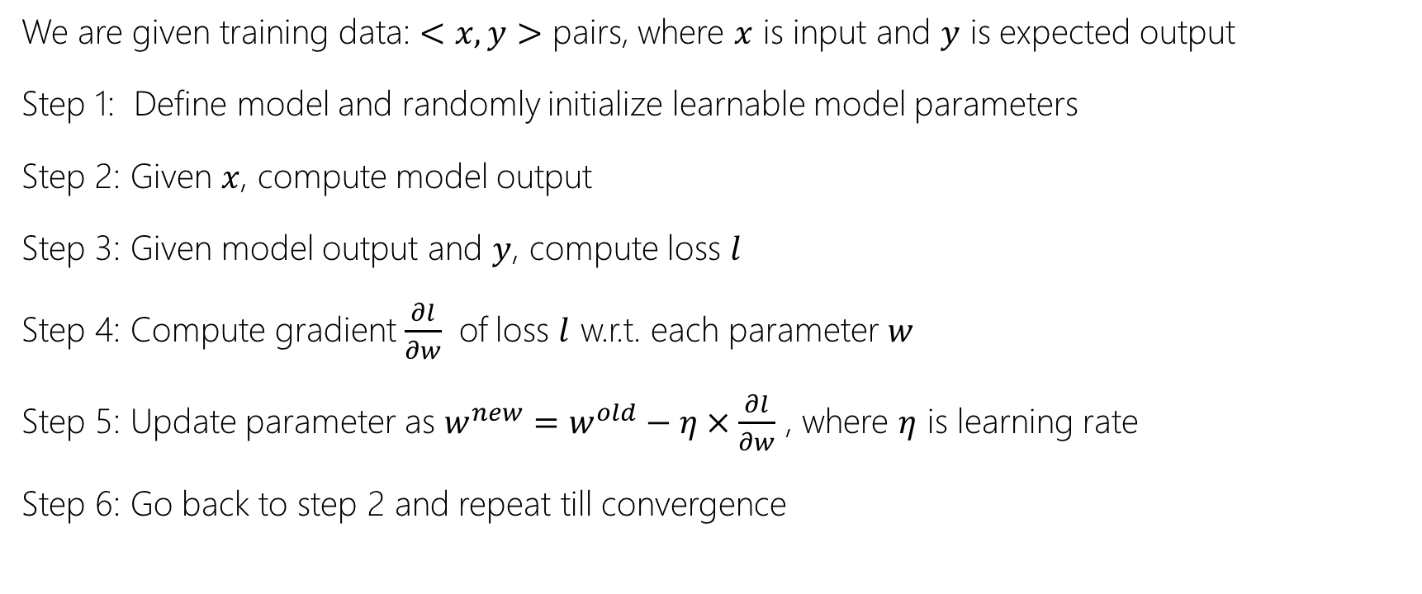
Gradient Descent
We are given training data: $<x, y>$ pairs, where $x$ is input and $y$ is expected output
Step 1: Define model and randomly initialize learnable model parameters
Step 2: Given $x$, compute model output
Step 3: Given model output and $y$, compute loss $l$
Step 4: Compute gradient $\frac{∂l}{∂w}$ of loss $l$ w.r.t. each parameter $w$
Step 5: Update parameter as $w^{new}=w^{old}−η×\frac{∂l}{∂w}$ , where $η$ is learning rate
Step 6: Go back to step 2 and repeat till convergence

Slide 15
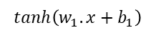
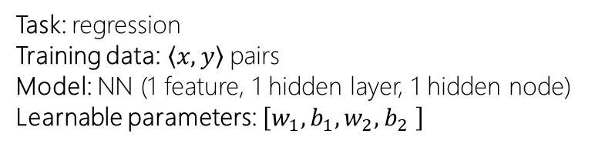
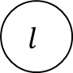
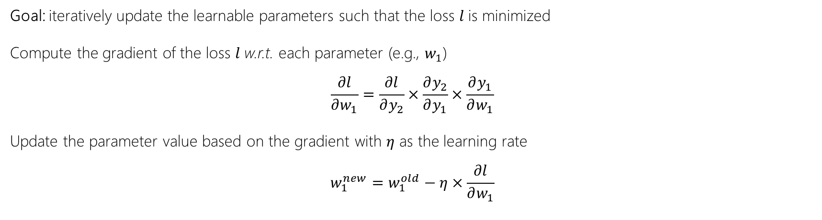
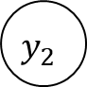
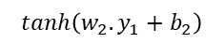
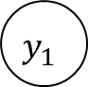
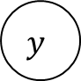
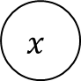
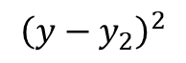
Gradient Descent
$$x$$
$$tanh\left(w_{1}.x+b_{1}\right)$$
$$y_{1}$$
$$tanh\left(w_{2}.y_{1}+b_{2}\right)$$
$$y_{2}$$
Task: regression
Training data:$\left\langle x,y\right\rangle$ pairs
Model: NN (1 feature, 1 hidden layer, 1 hidden node)
Learnable parameters: $\left[w_{1},b_{1},w_{2},b_{2} \right]$
$${\left(y−y_{2}\right)}^{2}$$
$$l$$
$$y$$
Goal: iteratively update the learnable parameters such that the loss $l$is minimized
Compute the gradient of the loss $l$w.r.t. each parameter (e.g., $w_{1}$)
$$\frac{∂l}{∂w_{1}}=\frac{∂l}{∂y_{2}}×\frac{∂y_{2}}{∂y_{1}}×\frac{∂y_{1}}{∂w_{1}}$$
Update the parameter value based on the gradient with $η$ as the learning rate
$$w_{1}^{new}=w_{1}^{old}−η×\frac{∂l}{∂w_{1}}$$
…and repeat

Slide 16
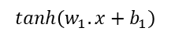
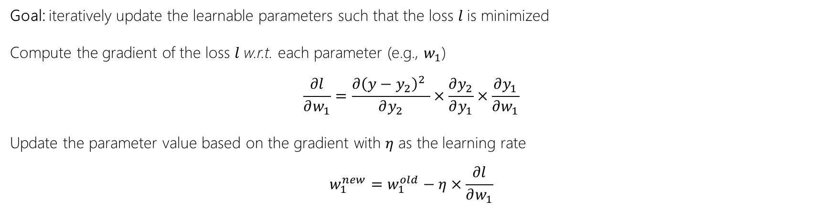
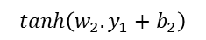
Gradient Descent
$$x$$
$$tanh\left(w_{1}.x+b_{1}\right)$$
$$y_{1}$$
$$tanh\left(w_{2}.y_{1}+b_{2}\right)$$
$$y_{2}$$
Task: regression
Training data:$\left\langle x,y\right\rangle$ pairs
Model: NN (1 feature, 1 hidden layer, 1 hidden node)
Learnable parameters: $\left[w_{1},b_{1},w_{2},b_{2} \right]$
$${\left(y−y_{2}\right)}^{2}$$
$$l$$
$$y$$
Goal: iteratively update the learnable parameters such that the loss $l$is minimized
Compute the gradient of the loss $l$w.r.t. each parameter (e.g., $w_{1}$)
$$\frac{∂l}{∂w_{1}}=\frac{∂{\left(y−y_{2}\right)}^{2} }{∂y_{2}}×\frac{∂y_{2}}{∂y_{1}}×\frac{∂y_{1}}{∂w_{1}}$$
Update the parameter value based on the gradient with $η$ as the learning rate
$$w_{1}^{new}=w_{1}^{old}−η×\frac{∂l}{∂w_{1}}$$
…and repeat

Slide 17
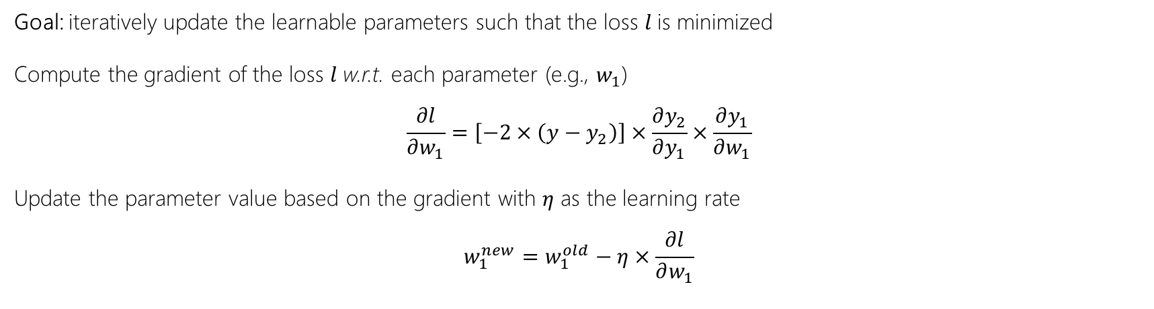
Gradient Descent
$$x$$
$$tanh\left(w_{1}.x+b_{1}\right)$$
$$y_{1}$$
$$tanh\left(w_{2}.y_{1}+b_{2}\right)$$
$$y_{2}$$
Task: regression
Training data:$\left\langle x,y\right\rangle$ pairs
Model: NN (1 feature, 1 hidden layer, 1 hidden node)
Learnable parameters: $\left[w_{1},b_{1},w_{2},b_{2} \right]$
$${\left(y−y_{2}\right)}^{2}$$
$$l$$
$$y$$
Goal: iteratively update the learnable parameters such that the loss $l$is minimized
Compute the gradient of the loss $l$w.r.t. each parameter (e.g., $w_{1}$)
$$\frac{∂l}{∂w_{1}}=\left[−2×\left(y−y_{2}\right)\right]×\frac{∂y_{2}}{∂y_{1}}×\frac{∂y_{1}}{∂w_{1}}$$
Update the parameter value based on the gradient with $η$ as the learning rate
$$w_{1}^{new}=w_{1}^{old}−η×\frac{∂l}{∂w_{1}}$$
…and repeat

Slide 18
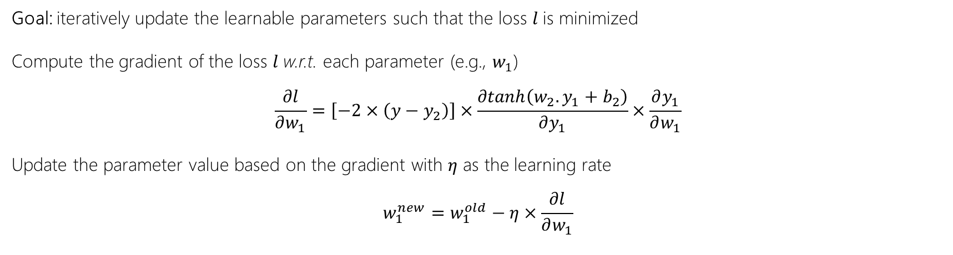
Gradient Descent
$$x$$
$$tanh\left(w_{1}.x+b_{1}\right)$$
$$y_{1}$$
$$tanh\left(w_{2}.y_{1}+b_{2}\right)$$
$$y_{2}$$
Task: regression
Training data:$\left\langle x,y\right\rangle$ pairs
Model: NN (1 feature, 1 hidden layer, 1 hidden node)
Learnable parameters: $\left[w_{1},b_{1},w_{2},b_{2} \right]$
$${\left(y−y_{2}\right)}^{2}$$
$$l$$
$$y$$
Goal: iteratively update the learnable parameters such that the loss $l$is minimized
Compute the gradient of the loss $l$w.r.t. each parameter (e.g., $w_{1}$)
$$\frac{∂l}{∂w_{1}}=\left[−2×\left(y−y_{2}\right)\right]×\frac{∂tanh\left(w_{2}.y_{1}+b_{2}\right)}{∂y_{1}}×\frac{∂y_{1}}{∂w_{1}}$$
Update the parameter value based on the gradient with $η$ as the learning rate
$$w_{1}^{new}=w_{1}^{old}−η×\frac{∂l}{∂w_{1}}$$
…and repeat

Slide 19
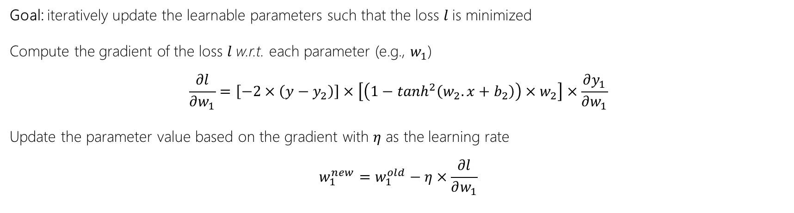
Gradient Descent
$$x$$
$$tanh\left(w_{1}.x+b_{1}\right)$$
$$y_{1}$$
$$tanh\left(w_{2}.y_{1}+b_{2}\right)$$
$$y_{2}$$
Task: regression
Training data:$\left\langle x,y\right\rangle$ pairs
Model: NN (1 feature, 1 hidden layer, 1 hidden node)
Learnable parameters: $\left[w_{1},b_{1},w_{2},b_{2} \right]$
$${\left(y−y_{2}\right)}^{2}$$
$$l$$
$$y$$
Goal: iteratively update the learnable parameters such that the loss $l$is minimized
Compute the gradient of the loss $l$w.r.t. each parameter (e.g., $w_{1}$)
$$\frac{∂l}{∂w_{1}}=\left[−2×\left(y−y_{2}\right)\right]×\left[\left(1−\tanh^{2}\left(w_{2}.x+b_{2}\right)\right){×w}_{2}\right]×\frac{∂y_{1}}{∂w_{1}}$$
Update the parameter value based on the gradient with $η$ as the learning rate
$$w_{1}^{new}=w_{1}^{old}−η×\frac{∂l}{∂w_{1}}$$
…and repeat

Slide 20
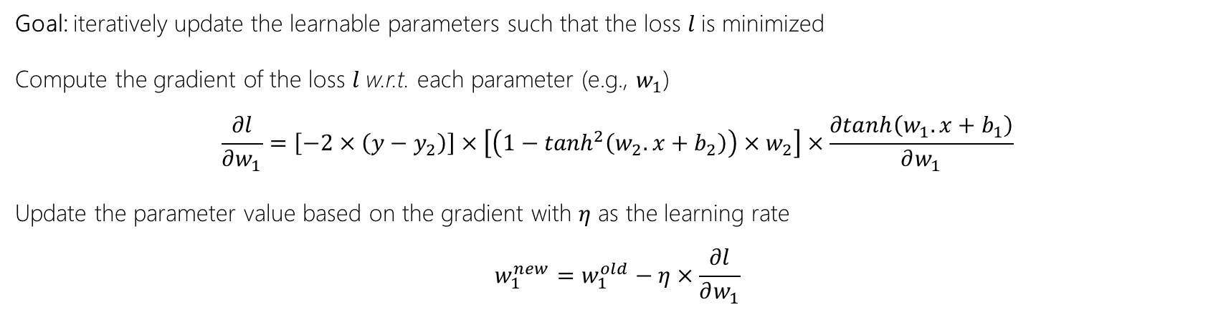
Gradient Descent
$$x$$
$$tanh\left(w_{1}.x+b_{1}\right)$$
$$y_{1}$$
$$tanh\left(w_{2}.y_{1}+b_{2}\right)$$
$$y_{2}$$
Task: regression
Training data:$\left\langle x,y\right\rangle$ pairs
Model: NN (1 feature, 1 hidden layer, 1 hidden node)
Learnable parameters: $\left[w_{1},b_{1},w_{2},b_{2} \right]$
$${\left(y−y_{2}\right)}^{2}$$
$$l$$
$$y$$
Goal: iteratively update the learnable parameters such that the loss $l$is minimized
Compute the gradient of the loss $l$w.r.t. each parameter (e.g., $w_{1}$)
$$\frac{∂l}{∂w_{1}}=\left[−2×\left(y−y_{2}\right)\right]×\left[\left(1−\tanh^{2}\left(w_{2}.x+b_{2}\right)\right){×w}_{2}\right]×\frac{∂tanh\left(w_{1}.x+b_{1}\right)}{∂w_{1}}$$
Update the parameter value based on the gradient with $η$ as the learning rate
$$w_{1}^{new}=w_{1}^{old}−η×\frac{∂l}{∂w_{1}}$$
…and repeat

Slide 21
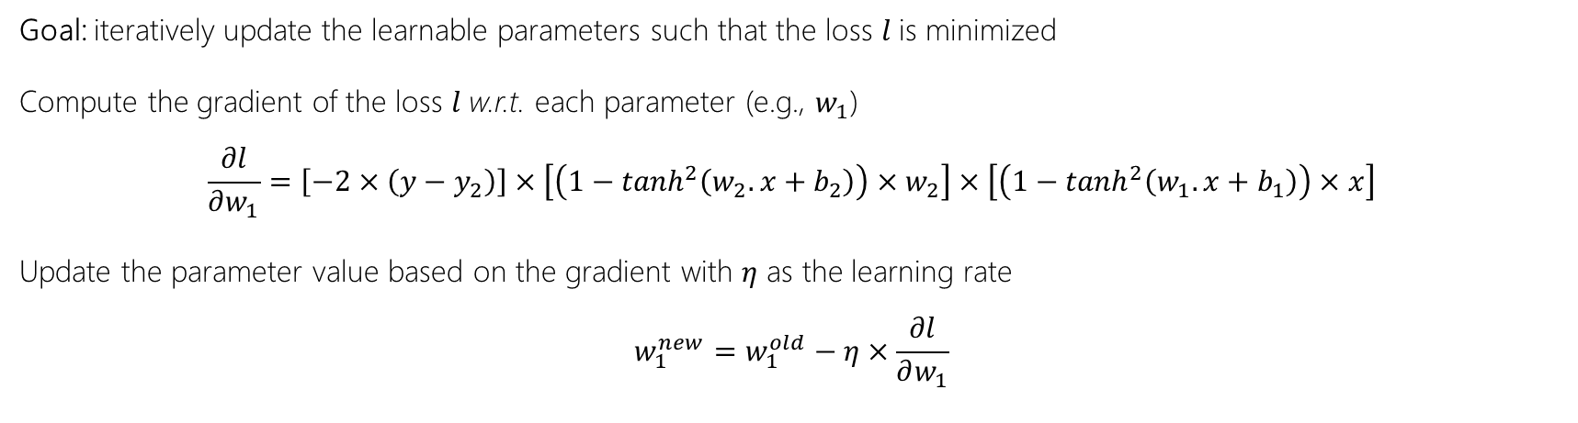
Gradient Descent
$$x$$
$$tanh\left(w_{1}.x+b_{1}\right)$$
$$y_{1}$$
$$tanh\left(w_{2}.y_{1}+b_{2}\right)$$
$$y_{2}$$
Task: regression
Training data:$\left\langle x,y\right\rangle$ pairs
Model: NN (1 feature, 1 hidden layer, 1 hidden node)
Learnable parameters: $\left[w_{1},b_{1},w_{2},b_{2} \right]$
$${\left(y−y_{2}\right)}^{2}$$
$$l$$
$$y$$
Goal: iteratively update the learnable parameters such that the loss $l$is minimized
Compute the gradient of the loss $l$w.r.t. each parameter (e.g., $w_{1}$)
$$\frac{∂l}{∂w_{1}}=\left[−2×\left(y−y_{2}\right)\right]×\left[\left(1−\tanh^{2}\left(w_{2}.x+b_{2}\right)\right){×w}_{2}\right]×\left[\left(1−\tanh^{2}\left(w_{1}.x+b_{1}\right)\right)×x\right]$$
Update the parameter value based on the gradient with $η$ as the learning rate
$$w_{1}^{new}=w_{1}^{old}−η×\frac{∂l}{∂w_{1}}$$
…and repeat

Slide 22
Exercise
Simple Neural Network from Scratch
Implement a simple multi-layer neural network with single input feature, single output, and single neuron per layer using (i) PyTorch and (ii) from scratch—and demonstrate that both approaches produce identical outcome.
https://github.com/spacemanidol/AFIRMDeepLearning2020/blob/master/NNPrimer.ipynb

Slide 23
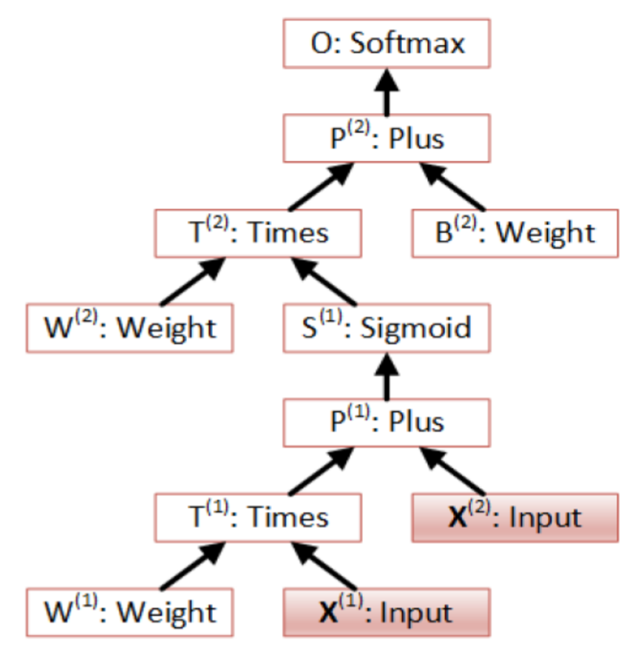
Computation Networks
The “Lego” approach to specifying neural architectures
Library of neural layers, each layer defines logic for:
Forward pass: compute layer output given layer input
Backward pass:
compute gradient of layer output w.r.t. layer inputs
compute gradient of layer output w.r.t. layer parameters (if any)
Chain nodes to create bigger and more complex networks

Slide 24

Questions?

Slide 25
The fundamentals of learning to rank

Slide 26





Most information retrieval (IR) systems present a ranked list of retrieved artifacts

Slide 27
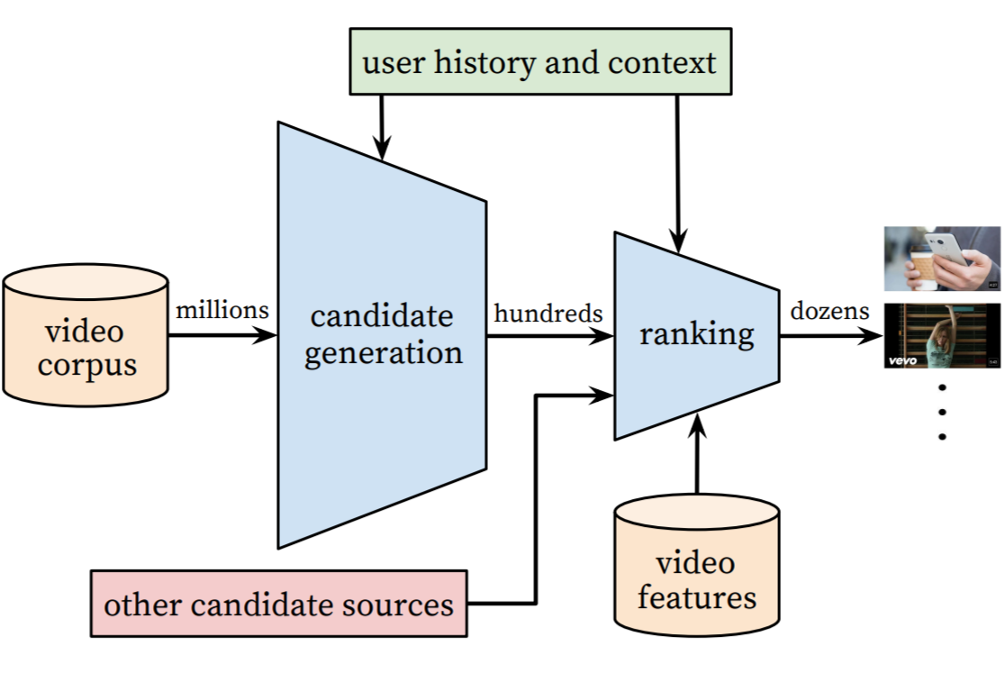
Learning to Rank (LTR)
”... the task to automatically construct a ranking model using training data, such that the model can sort new objects according to their degrees of relevance, preference, or importance.”
- Liu [2009]
Tie-Yan Liu. Learning to rank for information retrieval. Foundation and Trends in Information Retrieval, 2009.
Image source: https://storage.googleapis.com/pub-tools-public-publication-data/pdf/45530.pdf

Slide 28
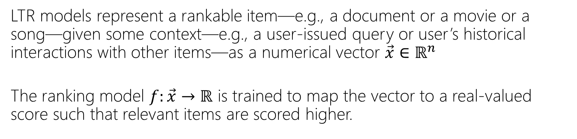
Problem formulation
LTR models represent a rankable item—e.g., a document or a movie or a song—given some context—e.g., a user-issued query or user’s historical interactions with other items—as a numerical vector $\vec{x}∈ℝ^{n}$
The ranking model $f:\vec{x}→ℝ$ is trained to map the vector to a real-valued score such that relevant items are scored higher.

Slide 29



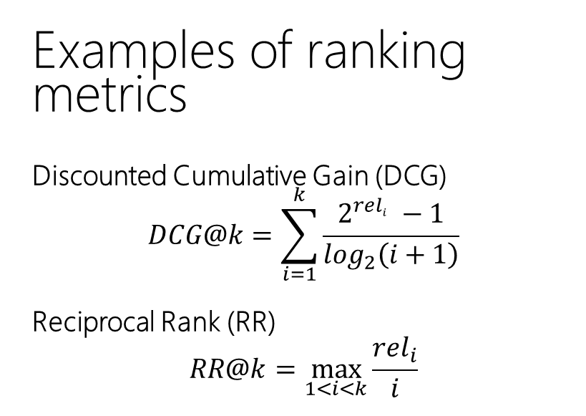
Why is ranking challenging?
Examples of ranking metrics
Discounted Cumulative Gain (DCG)
$$DCG@k=\sum_{i=1}^{k}{\frac{2^{{rel}_{i}^{}}−1}{\log_{2}\left(i+1\right)}}$$
Reciprocal Rank (RR)
$$RR@k=\max_{1<i<k}{\frac{{rel}_{i}}{i}}$$
Rank based metrics, such as DCG and MRR, are non-smooth / non-differentiable

Slide 30
Features
They can often be categorized as:
Query-independent or static features
e.g., incoming link count and document length
Query-dependent or dynamic features
e.g., BM25
Query-level features
e.g., query length
Traditional L2R models employ hand-crafted features that encode IR insights

Slide 31
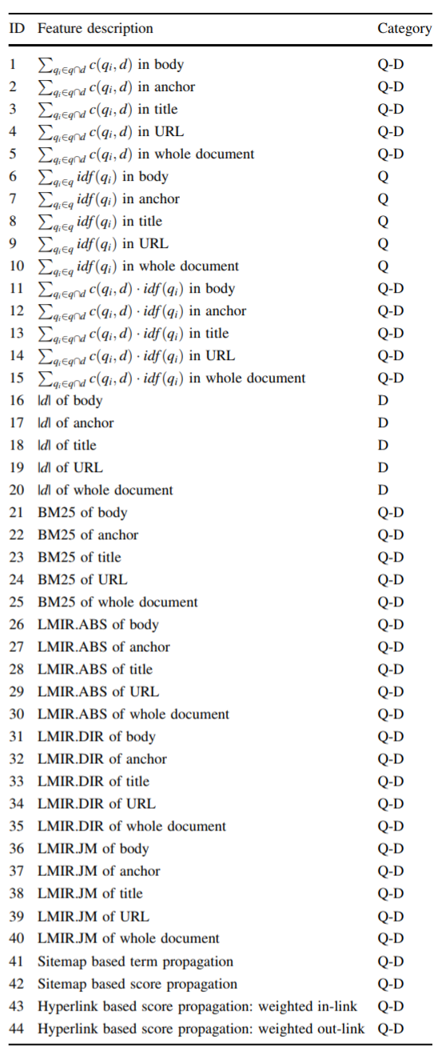
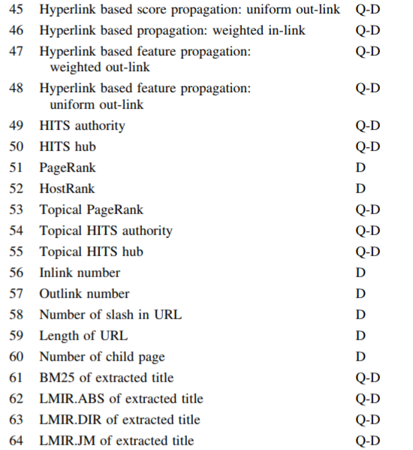
Features
Tao Qin, Tie-Yan Liu, Jun Xu, and Hang Li. LETOR: A Benchmark Collection for Research on Learning to Rank for Information Retrieval, Information Retrieval Journal, 2010

Slide 32
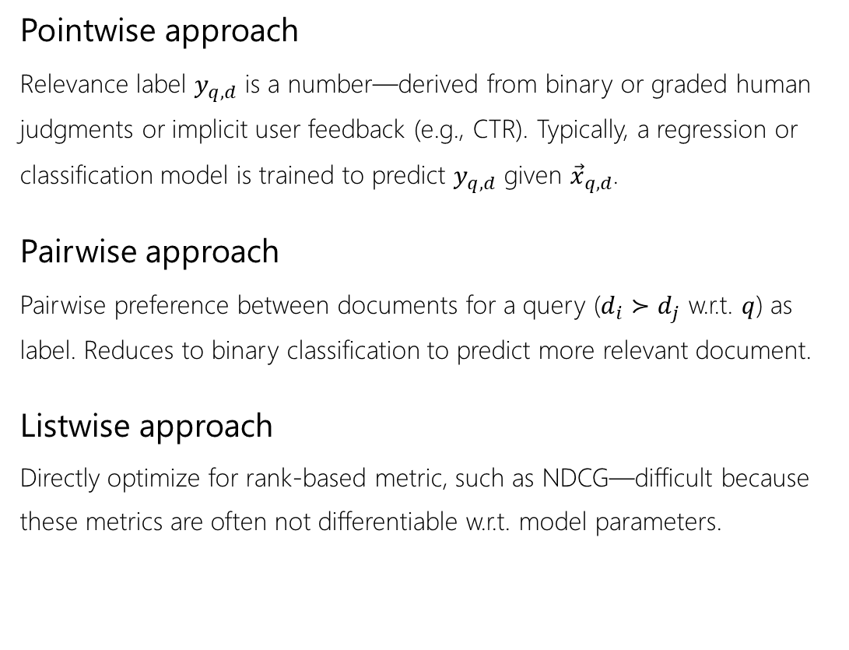
Approaches
Pointwise approach
Relevance label $y_{q,d}$ is a number—derived from binary or graded human judgments or implicit user feedback (e.g., CTR). Typically, a regression or classification model is trained to predict $y_{q,d}$ given ${\vec{x}}_{q,d}$.
Pairwise approach
Pairwise preference between documents for a query ($d_{i}≻d_{j}$ w.r.t. $q$) as label. Reduces to binary classification to predict more relevant document.
Listwise approach
Directly optimize for rank-based metric, such as NDCG—difficult because these metrics are often not differentiable w.r.t. model parameters.
Liu [2009] categorizes different LTR approaches based on training objectives:
Tie-Yan Liu. Learning to rank for information retrieval. Foundation and Trends in Information Retrieval, 2009.

Slide 33

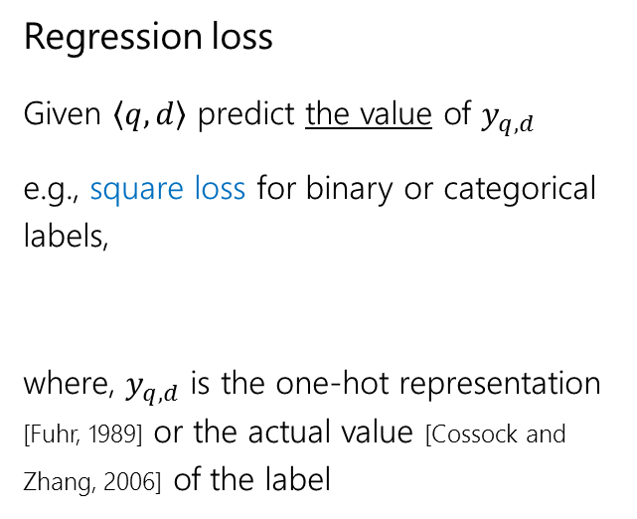
Pointwise objectives
0
1
1
labels
Regression loss
Given $\left\langle q,d\right\rangle$ predict the value of $y_{q,d}$
e.g., square loss for binary or categorical labels,
where, $y_{q,d}$ is the one-hot representation [Fuhr, 1989] or the actual value [Cossock and Zhang, 2006] of the label
prediction
Norbert Fuhr. Optimum polynomial retrieval functions based on the probability ranking principle. ACM TOIS, 1989.
David Cossock and Tong Zhang. Subset ranking using regression. In COLT, 2006.

Slide 34
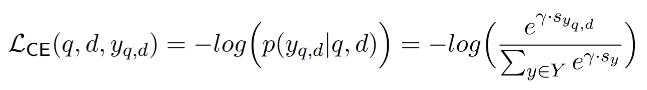
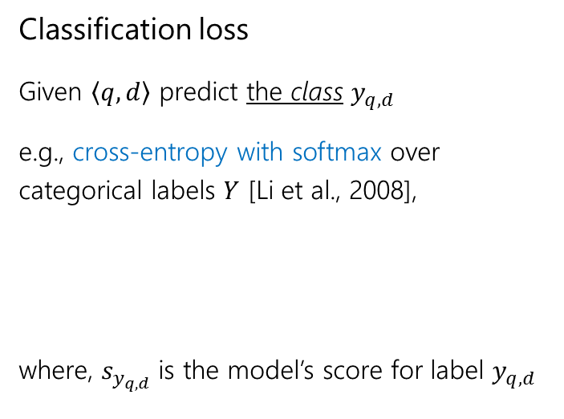
Pointwise objectives
0
1
labels
Classification loss
Given $\left\langle q,d\right\rangle$ predict the class $y_{q,d}$
e.g., cross-entropy with softmax over categorical labels $Y$ [Li et al., 2008],
where, $s_{y_{q,d}}$ is the model’s score for label $y_{q,d}$
prediction
Ping Li, Qiang Wu, and Christopher J Burges. Mcrank: Learning to rank using multiple classification and gradient boosting. In NIPS, 2008.

Slide 35



Pairwise objectives
Pairwise loss generally has the following form [Chen et al., 2009],
where, $φ$ can be,
Hinge function $φ\left(z\right)=max\left(0, 1−z\right)$ [Herbrich et al., 2000]
Exponential function $φ\left(z\right)=e^{−z}$ [Freund et al., 2003]
Logistic function $φ\left(z\right)=log\left(1+e^{−z}\right)$ [Burges et al., 2005]
Others…
Pairwise loss minimizes the average number of inversions in ranking—i.e., $d_{i}≻d_{j}$ w.r.t. $q$but $d_{j}$ is ranked higher than $d_{i}$
Given $\left\langle q,d_{i},d_{j}\right\rangle$, predict the more relevant document
For $\left\langle q,d_{i} \right\rangle$ and $\left\langle q, d_{j}\right\rangle$,
Feature vectors: ${\vec{x}}_{i}$ and ${\vec{x}}_{j}$
Model scores: $s_{i}=f\left({\vec{x}}_{i}\right)$ and $s_{j}=f\left({\vec{x}}_{j}\right)$
Wei Chen, Tie-Yan Liu, Yanyan Lan, Zhi-Ming Ma, and Hang Li. Ranking measures and loss functions in learning to rank. In NIPS, 2009.
Ralf Herbrich, Thore Graepel, and Klaus Obermayer. Large margin rank boundaries for ordinal regression. 2000.
Yoav Freund, Raj Iyer, Robert E Schapire, and Yoram Singer. An efficient boosting algorithm for combining preferences. In JMLR, 2003.
Chris Burges, Tal Shaked, Erin Renshaw, Ari Lazier, Matt Deeds, Nicole Hamilton, and Greg Hullender. Learning to rank using gradient descent. In ICML, 2005.

Slide 36

Pairwise objectives
0
1
pairwise preference
RankNet loss
Pairwise loss function proposed by Burges et al. [2005]—an industry favourite [Burges, 2015]
Predicted probabilities: $p_{ij}=p\left(s_{i}>s_{j}\right)≡\frac{e^{γ.s_{i}^{}}}{e^{γ.s_{i}^{}}+e^{γ.s_{j}^{}}}=\frac{1}{1+e^{−γ.\left(s_{i}−s_{j}\right) }}$
Desired probabilities: ${\overline{p}}_{ij}=1$ and ${\overline{p}}_{ji}=0$
Computing cross-entropy between $p$ and $\overline{p}$
$$ℒ_{RankNet}=−{\overline{p}}_{ij}.log\left(p_{ij}\right)−{\overline{p}}_{ji}.log\left(p_{ji}\right)=−log\left(p_{ij}\right)=log\left(1+e^{−γ.\left(s_{i}−s_{j}\right) }\right)$$
score
Chris Burges, Tal Shaked, Erin Renshaw, Ari Lazier, Matt Deeds, Nicole Hamilton, and Greg Hullender. Learning to rank using gradient descent. In ICML, 2005.
Chris Burges. RankNet: A ranking retrospective. https://www.microsoft.com/en-us/research/blog/ranknet-a-ranking-retrospective/. 2015.

Slide 37

A generalized cross-entropy loss
An alternative loss function assumes a single relevant document $d^{+}$ and compares it against the full collection $D$
Predicted probabilities: $p\left(d^{+}|q\right)=\frac{e^{γ.s\left(q,d^{+}\right) }}{\sum_{d∈D}{e^{γ.s\left(q,d \right) }}}$
The cross-entropy loss is then given by,
$$ℒ_{CE}\left(q,d^{+},D\right)=−log\left(p\left(d^{+}|q\right)\right)=−log\left(\frac{e^{γ.s\left(q,d^{+}\right) }}{\sum_{d∈D}{e^{γ.s\left(q,d \right) }}}\right)$$
Computing the softmax over the full collection is prohibitively expensive—LTR models typically consider few negative candidates [Huang et al., 2013, Shen et al., 2014, Mitra et al., 2017]
Po-Sen Huang, Xiaodong He, Jianfeng Gao, Li Deng, Alex Acero, and Larry Heck. Learning deep structured semantic models for web search using clickthrough data. In CIKM, 2013.
Yelong Shen, Xiaodong He, Jianfeng Gao, Li Deng, and Gregoire Mesnil. A latent semantic model with convolutional-pooling structure for information retrieval. In CIKM, 2014.
Bhaskar Mitra, Fernando Diaz, and Nick Craswell. Learning to match using local and distributed representations of text for web search. In WWW, 2017.

Slide 38

Listwise objectives
Blue: relevant Gray: non-relevant
NDCG and ERR higher for left but pairwise errors less for right
Due to strong position-based discounting in IR measures, errors at higher ranks are much more problematic than at lower ranks
But listwise metrics are non-continuous and non-differentiable
[Burges, 2010]
Christopher JC Burges. From ranknet to lambdarank to lambdamart: An overview. Learning, 2010.

Slide 39

Listwise objectives
Burges et al. [2006] make two observations:
To train a model we don’t need the costs themselves, only the gradients (of the costs w.r.t model scores)
It is desired that the gradient be bigger for pairs of documents that produces a bigger impact in NDCG by swapping positions
LambdaRank loss
Multiply actual gradients with the change in NDCG by swapping the rank positions of the two documents
Christopher JC Burges, Robert Ragno, and Quoc Viet Le. Learning to rank with nonsmooth cost functions. In NIPS, 2006.

Slide 40


Listwise objectives
Smooth DCG
Wu et al. [2009] compute a “smooth” rank of documents as a function of their scores
This “smooth” rank can be plugged into a ranking metric, such as MRR or DCG, to produce a smooth ranking loss
Mingrui Wu, Yi Chang, Zhaohui Zheng, and Hongyuan Zha. Smoothing DCG for learning to rank: A novel approach using smoothed hinge functions. In CIKM, 2009.

Slide 41

Listwise objectives
ListNet loss
Cao et al. [2007] propose to compute the probability distribution over all possible permutations based on model score and ground-truth labels. The loss is then given by the K-L divergence between these two distributions.
This is computationally very costly, computing permutations of only the top-K items makes it slightly less prohibitive.
ListMLE loss
Xia et al. [2008] propose to compute the probability of the ideal permutation based on the ground truth. However, with categorical labels more than one permutation is possible.
According to the Luce model [Luce, 2005], given four items $\left\{d_{1},d_{2},d_{3},d_{4}\right\}$ the probability of observing a particular rank-order, say $\left[d_{2},d_{1},d_{4},d_{3}\right]$, is given by:
where, $π$ is a particular permutation and $φ$ is a transformation (e.g., linear, exponential, or sigmoid) over the score $s_{i}$ corresponding to item $d_{i}$
R Duncan Luce. Individual choice behavior. 1959.
Zhe Cao, Tao Qin, Tie-Yan Liu, Ming-Feng Tsai, and Hang Li. Learning to rank: from pairwise approach to listwise approach. In ICML, 2007.
Fen Xia, Tie-Yan Liu, Jue Wang, Wensheng Zhang, and Hang Li. Listwise approach to learning to rank: theory and algorithm. In ICML, 2008.

Slide 42





http://msmarco.org
We will host the 4th edition of the Deep Learning track at TREC 2022; please consider participating!
https://microsoft.github.io/msmarco/TREC-Deep-Learning

Slide 43





AI & Society
Real-world AI systems are inherently sociotechnical in nature; they are deployed in context of existing social structures and codify existing (oppressive) power structures
Machine learning models that learn from large-scale real-world datasets have been shown to replicate and amplify social harms, incl. misogyny, racism, casteism, antisemitism, Islamophobia, homophobia, transphobia, and ableism
It is becoming increasingly critical for AI researchers/practitioners to not only develop the skills to solve computational and modeling challenges, but also to master the skills necessary to critically analyze the role of said technology in sociopolitical contexts

Slide 44

Questions?
@UnderdogGeek bmitra@microsoft.com

